Slide 1
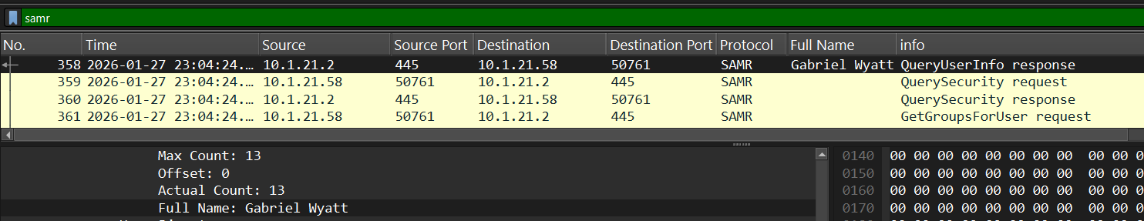
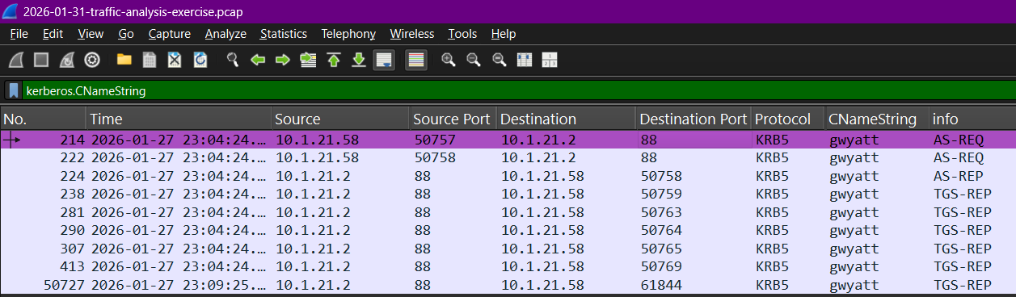
2026-01-31 - Lumma in the Room-ah! :Victim Identification
IP Address: 10.1.21.58
MAC Address: 00:21:5d:c8:0e:f2
Host Name: DESKTOP-ES9F3ML
User Account: gwyatt
Full Name: Gabriel Wyatt
Packets originating from IP 10.1.21.58 will show the machine name DESKTOP-ES9F3ML. Check the Packet Details window below under Ethernet II.
Filters used: nbns, samr, and kerberos.CNameString to look for the identity of the victim
When using these filters, observe packets with a Source IP of 10.1.21.58, which will display the machine name as DESKTOP-ES9F3ML. The MAC address can then be checked in the Packet Details window under Ethernet II.

Slide 2
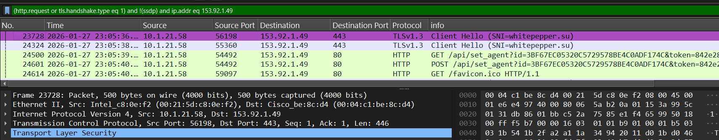
Point of Infection & C2 Traffic
Malware Type: Lumma Stealer
Malicious IP: 153.92.1.49
Port: TCP 80 และ 443
Malicious Domain: whitepepper.su
Filter detailed method: (http.request or tls.handshake.type eq 1) and !(ssdp) and ip.addr eq 153.92.1.49
We observed HTTP GET and POST requests sent to /api/set_agent?id=31 on the whitepepper.su domain, which is Lumma Stealer's Return (C2) behavior.

Slide 3
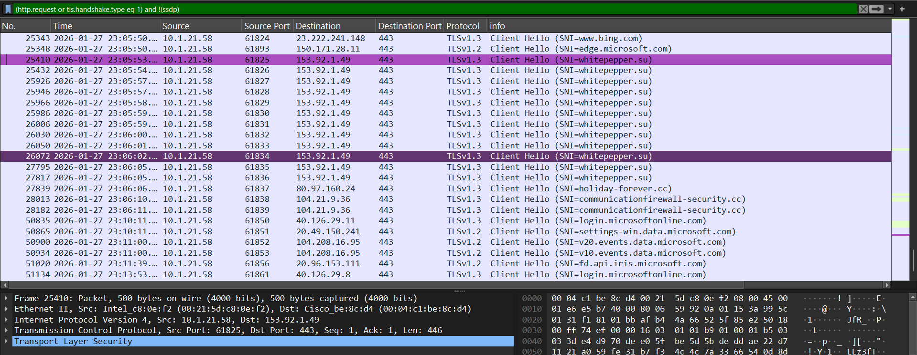
Follow-up Malware & Conclusion
Follow-up Domains: Traffic was found connecting to holiday-forever.cc and communicationfirewall-security.cc.
Check the time period after installing whitepepper.su (after 23:06:05); you will find Client Hello (TLS) requests directed to holiday-forever.cc and communicationfirewall-security.cc.
Conclusion: In summary, Gabriel Wyatt's machine was infected with Lumma Stealer malware, connecting to the C2 domain whitepepper.su (IP 153.92.1.49) and subsequently running the malware to other malicious domains (.cc family).

